Slide 1



Research by (outcomes questionnaire) numbers: uses, limits, and harms
Dr Andi Fugard (they/them)
29 Oct 2019
a.fugard@bbk.ac.uk
@InductiveStep

Slide 2

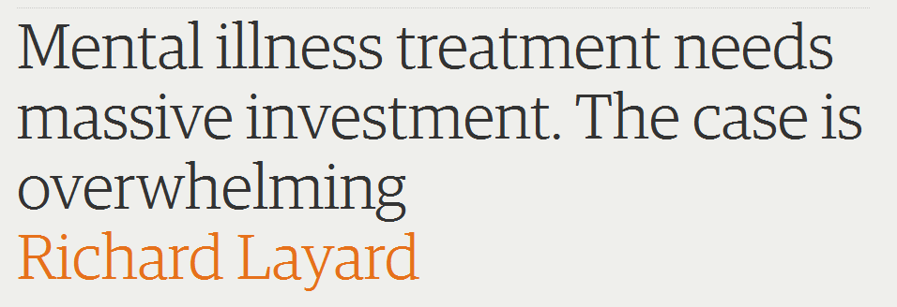
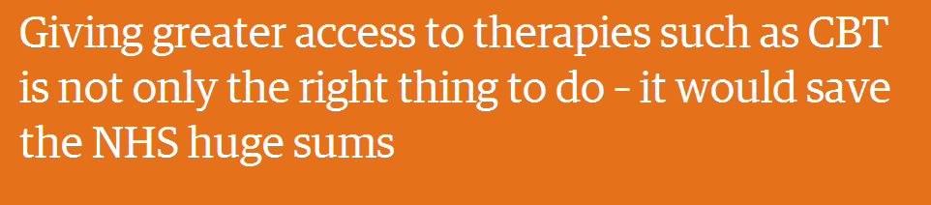

Slide 3
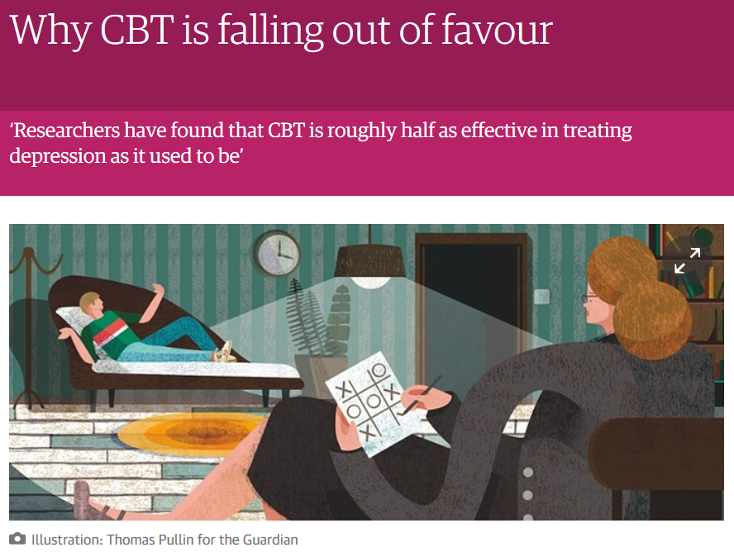

Slide 4
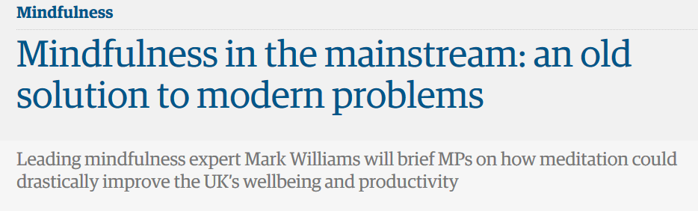


Slide 5

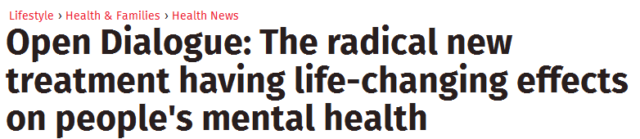


Slide 6
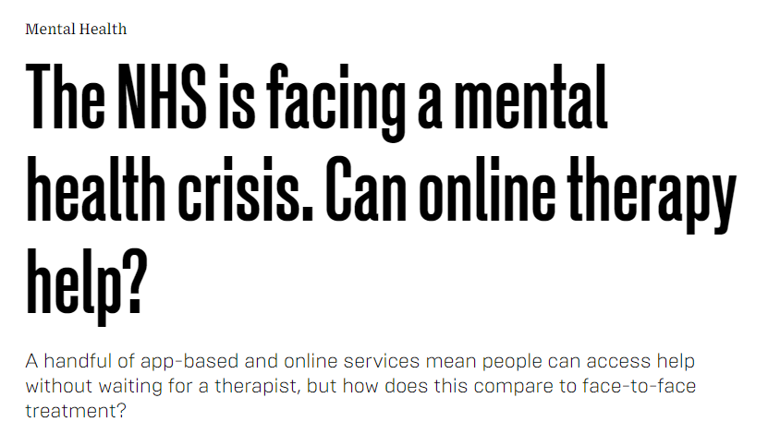

Slide 7


“After spending the last year building a beta and collecting clinical data, Woebot Labs Inc. just launched the full commercial product—a cheeky, personalized chatbot that checks on you once a day for the price of $39 a month.”
https://www.wired.com/2017/06/facebook-messenger-woebot-chatbot-therapist/

Slide 8
“What works for whom?”
“What mental health care should Treasury fund?”
“Should I (pay to) see a therapist?”
“Which brand of therapy…?”
“Which therapist?”

Slide 9

19 October, 2017
“Readers may …be interested to know that data from the NHS’s psychological therapies programme dataset demonstrates that psychodynamic psychotherapy helped patients to recover in fewer sessions on average (5.7 sessions) than CBT (5.8 sessions), the most widely available therapy.”
http://tinyurl.com/bpcevidence

Slide 10
Answer as quickly as possible the first word that comes to your mind
voyage

Slide 11
Answer as quickly as possible the first word that comes to your mind
kiss

Slide 12
Answer as quickly as possible the first word that comes to your mind
money

Slide 13
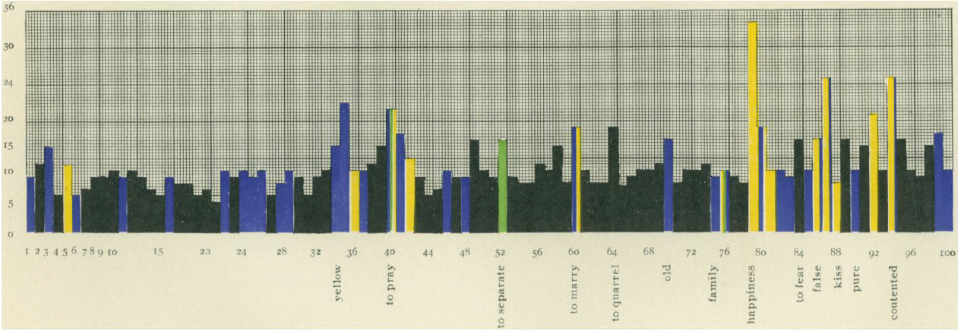
No reaction
Repetition of stimulus
Jung, C. G. (1910). The Association Method. American Journal of Psychology, 21, 219–269
Laughing/mistakes

Slide 14
Testing whether therapies (and apps) help
Meta- analysis
Pre-post outcome
Expert opinion
RCT
Quasi-experimental

Slide 15
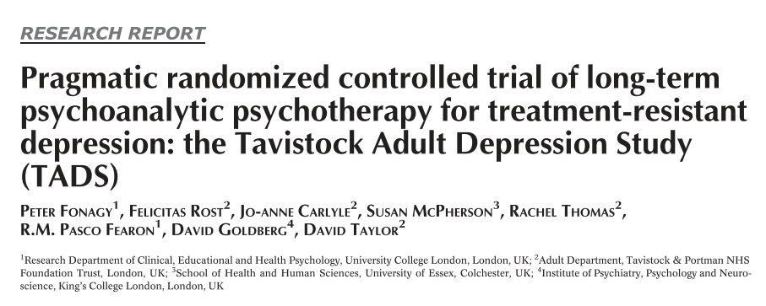

Slide 16



















Control group
Therapy

Slide 17
Two great things about randomisation (e.g., Caze, Benjamin, & Senn, 2012)
You don’t need to know all potential confounds – of which there will be 1000s
They don’t have to be equally balanced between the groups, just randomly distributed

Slide 18
RCT
Control
Effect
Therapy
Time 1
Time 2

Slide 19
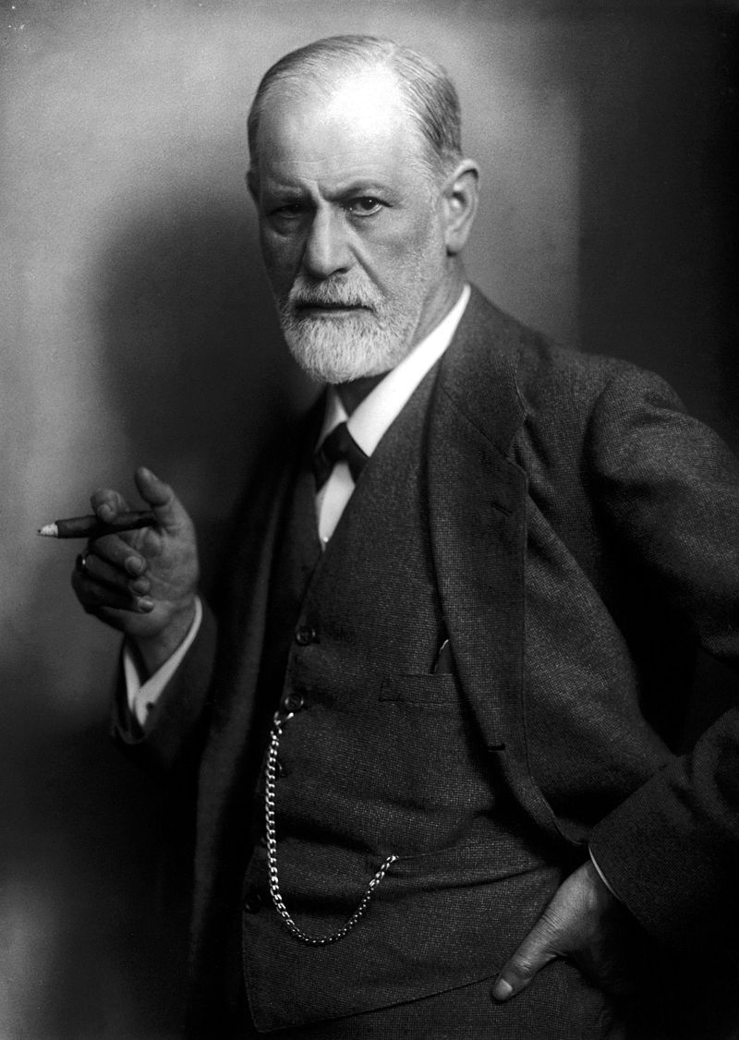
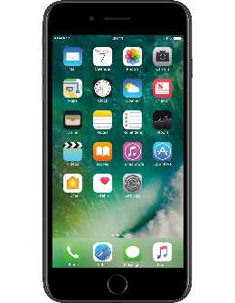
RCTs are special
Therapy developers often directly supervise
Big research team
Highly motivated/selected practitioners
Carefully selected participants
£££ for the evaluation

Slide 20
Routine practice
Control
Therapy
Time 1
Time 2

Slide 21
Routine practice
Effect?
Therapy
Time 1
Time 2

Slide 22
Routine practice
Effect?
Therapy
Time 1
Time 2

Slide 23
Routine practice
Therapy
Effect?
Time 1
Time 2

Slide 24
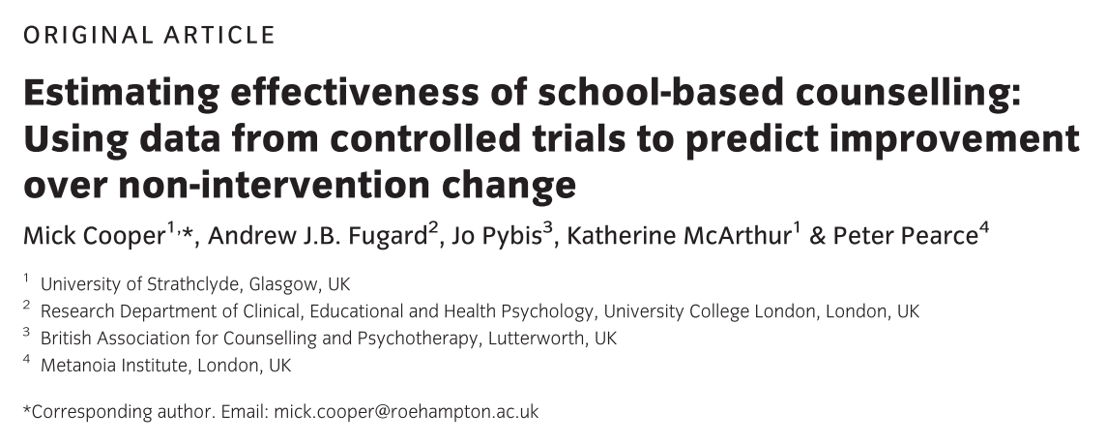

Slide 25
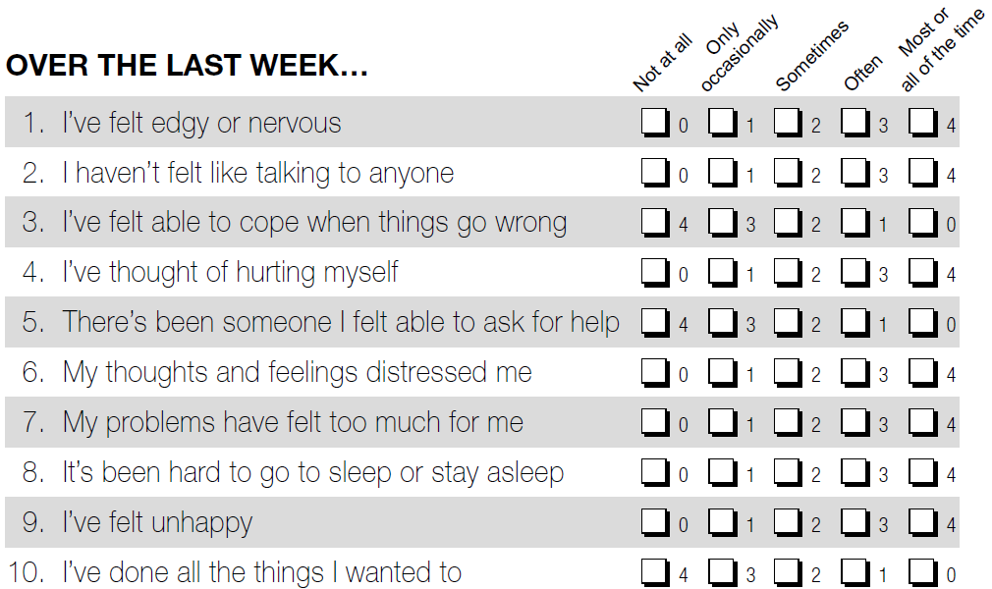
How are you feeling? (YP-CORE; Twigg et al., 2009; 2016)

Slide 26
Introducing ENOs: a partial solution to the missing control group problem
Use waiting list control data from school counselling RCTs
Model change over time from the starting scores
Giving a formula for an estimated non-intervention outcome (ENO)
Estimated intervention effect
= ENO – actual outcome

Slide 27
Routine practice
Estimated non-intervention outcome (ENO)
Estimated
intervention
effect
Intervention
Time 1
Time 2

Slide 28
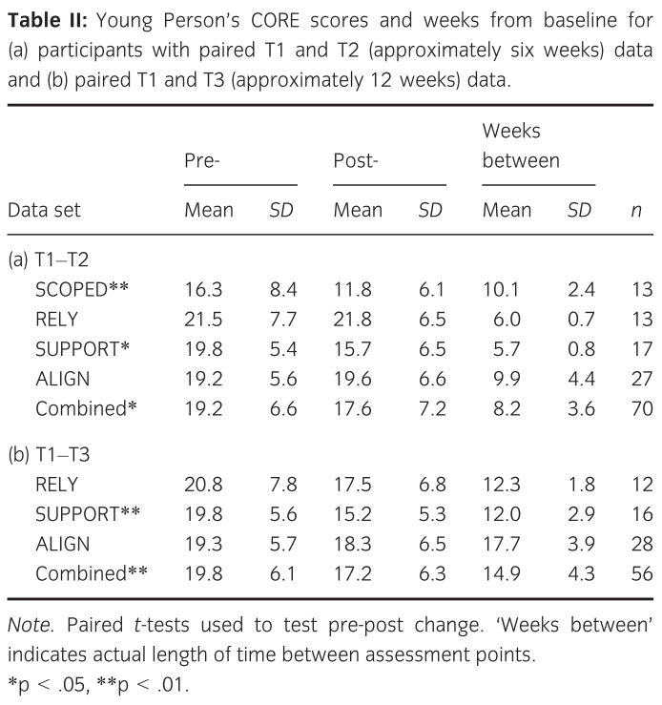

Slide 30
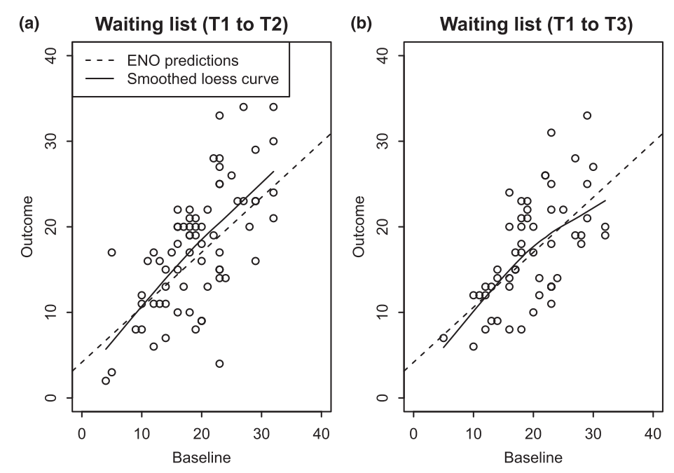
Predicting outcome from baseline scores in waiting lists (35% of variance explained)

Slide 31
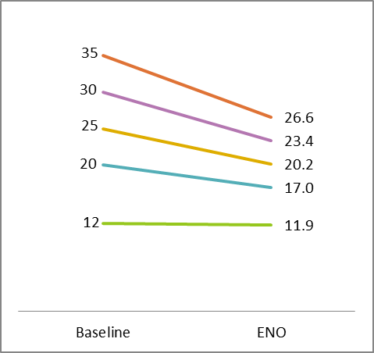
This gives us a simple formula for ENOs
ENO = 4.17 + 0.64 × baseline

Slide 32
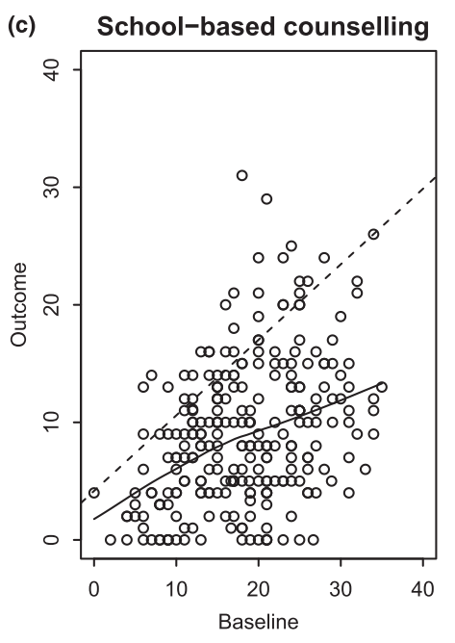
Testing the approach in routine school counselling data (N = 256)
Average symptoms at end of counselling lower than predicted by ENO ☺

Slide 33
Applying to data from 256 young people (Cohen’s d: 0.8 is a “large” effect)
Still large (and was statistically significant)

Slide 34
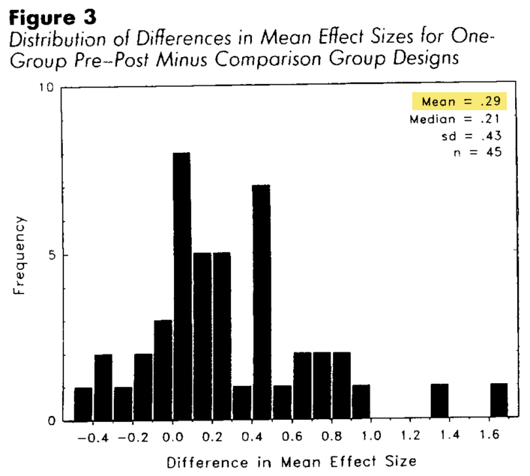
Difference replicates a well-known meta-analysis
We found a difference of 0.33 in effect sizes
Meta-analysis by Lipsey and Wilson (1993) of 45 studies found 0.29 difference

Slide 35

Back to RCTs…

Slide 36
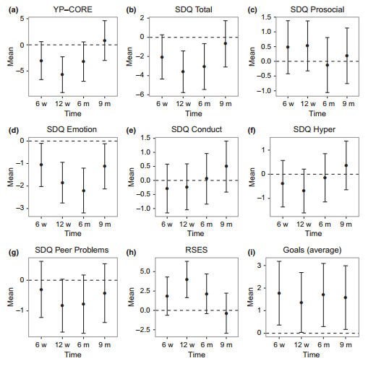

Slide 37
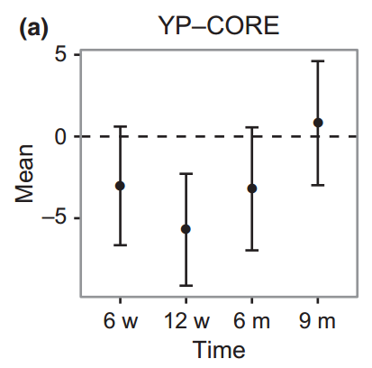

Slide 38

Good news at 6 to 12 weeks! But… evidence also needed at longer-term follow up…
“… such initial gains tend not to last... Rather like tender plants that thrive only in a greenhouse, it seems that people find that there is still a cold and hostile world waiting for them at the end of their therapy sessions…”
(David Smail, 2005)

Slide 39
‘You come from a school of psychology which suffers under the delusion that statistics are a guarantee of “objective” data. […] no amount of statistical “hard fact” can alter such extremely subjective and politically-driven concepts as “belief”, “affection” and “conscientiousness” […] Abstracted from the specific contexts in which these words might have meaning - a particular religious practice, a love affair, a work culture - they mean next-to-nothing as descriptions of an individual's personality.
‘Your questionnaires are reductive and - I want to put this gently but I can't - insulting.’
Ben Watson, MILITANT ESTHETIX www.militantesthetix.co.uk/psycho/psychfront.htm

Slide 40


Slide 41


Slide 42
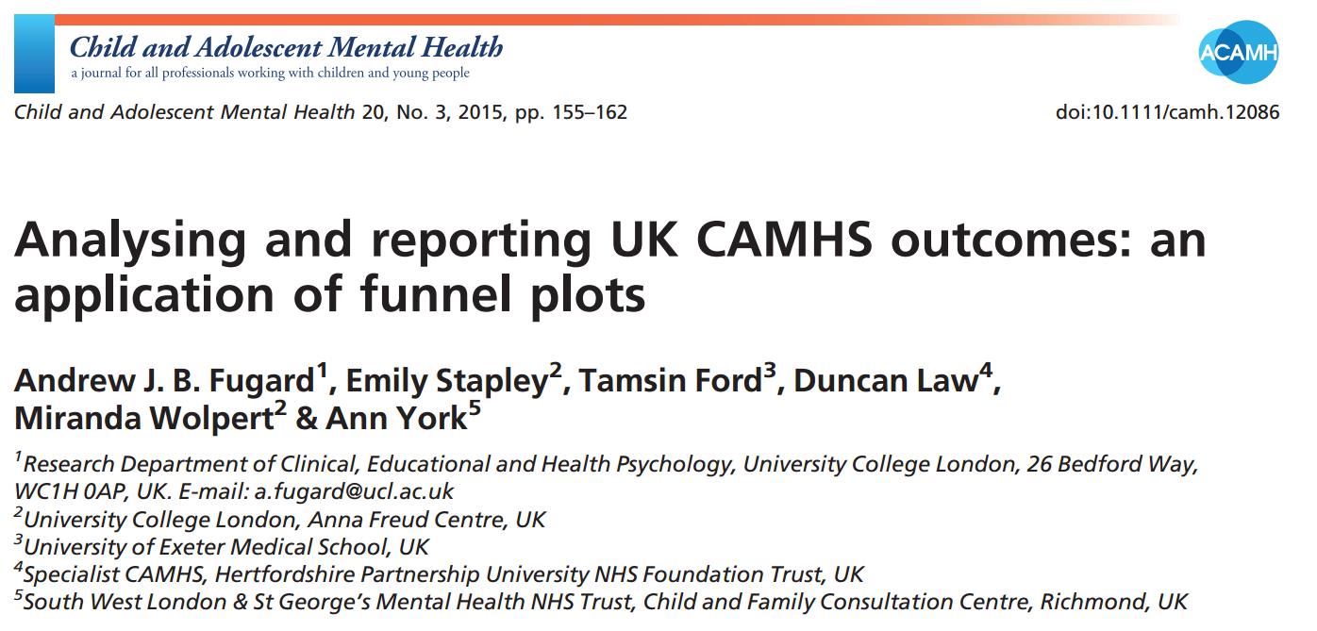

Slide 43
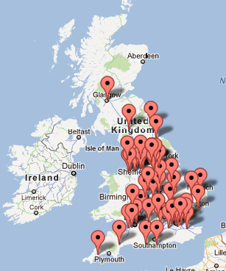
Data (Child Outcomes Research Consortium)
15,771 episodes of care
51 services (45 NHS)
SDQ-Parent measure

Slide 44
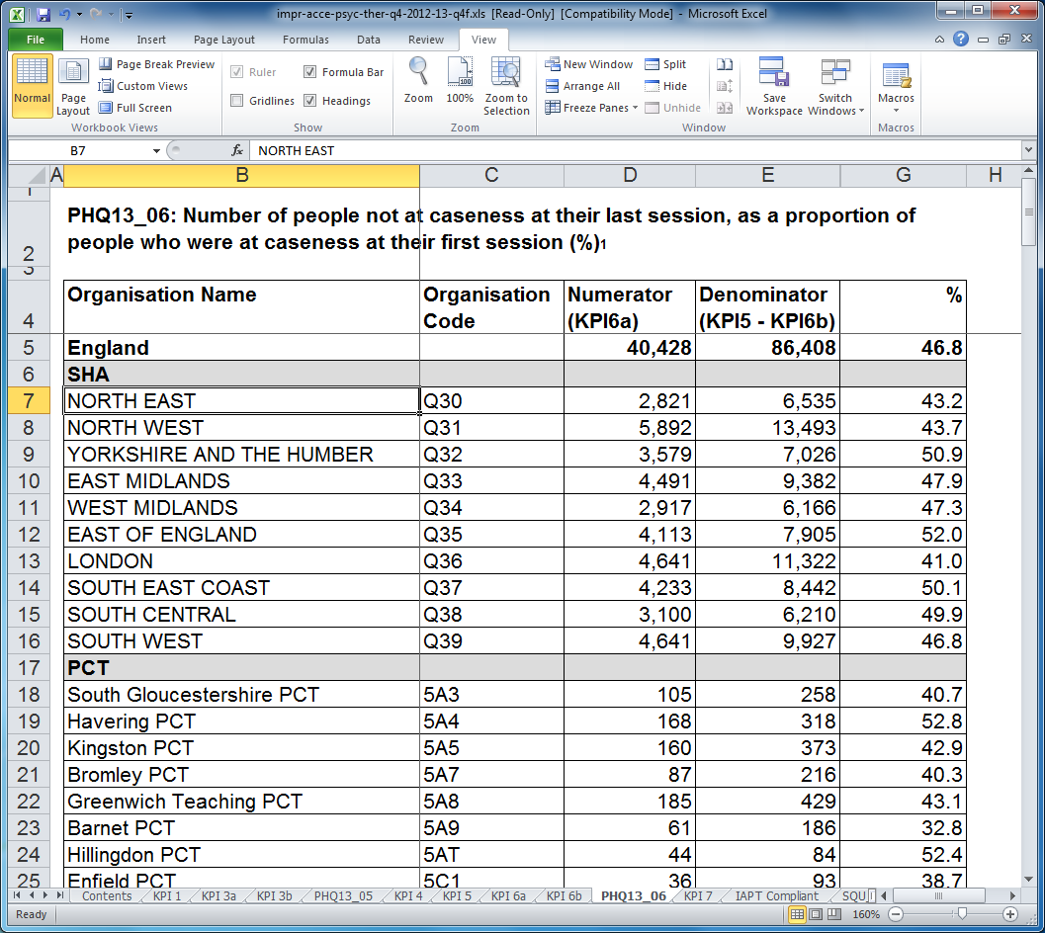
Adult mental health outcome data in UK – downloadable Excel tables

Slide 45
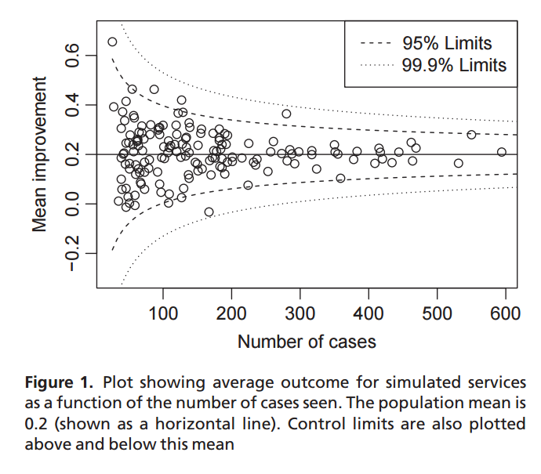

Slide 46
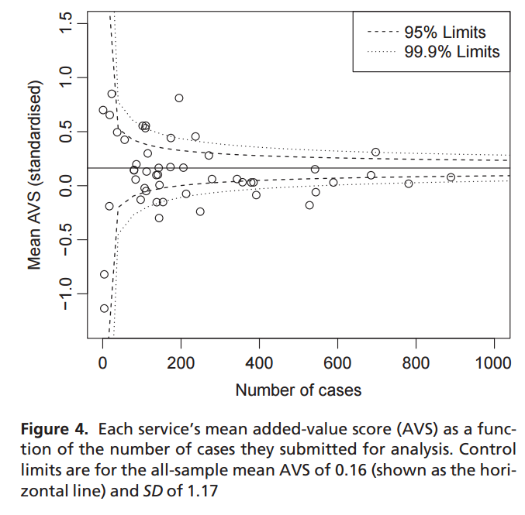
ES = 0.16
I² = 94.9%
“considerable” heterogeneity

Slide 47


Slide 48
Transfering “questionable research practices” to practice-based evidence
Mental health services, counsellors, therapists, app developers, charities want to maintain funding
Now required to collect evidence of effectiveness
All this has an impact on (apparent) outcomes

Slide 49
Example issues
Service restructuring, a.k.a. “redisorganisation”
Post-intervention data collection bias
Payment linked to outcomes
Cost-cutting, leading to fewer well-trained staff

Slide 50
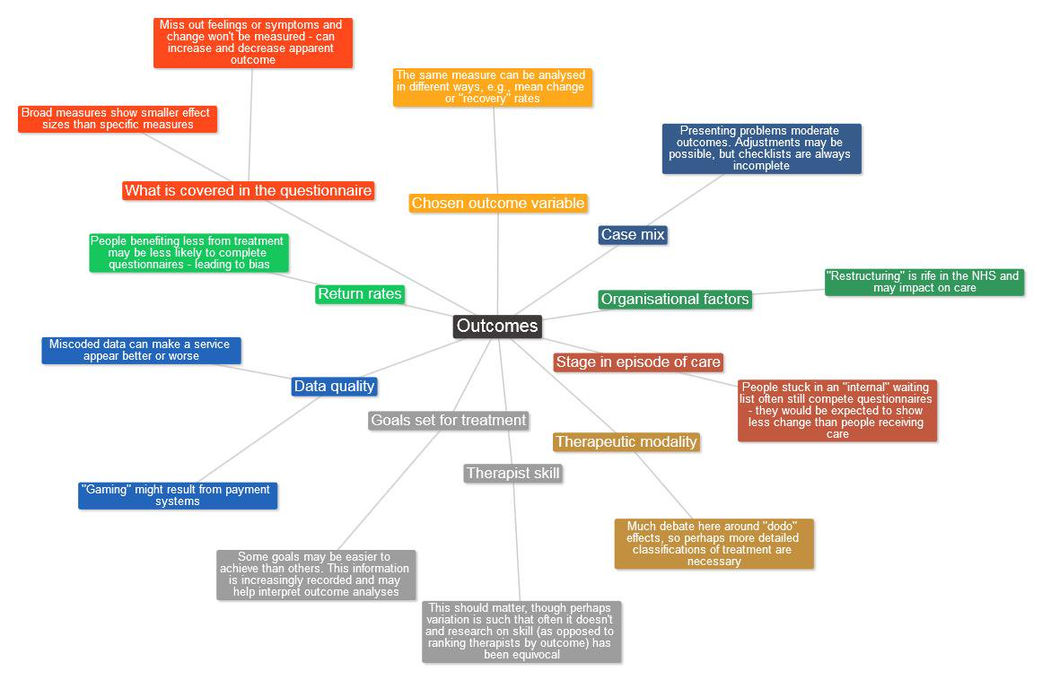

Slide 51
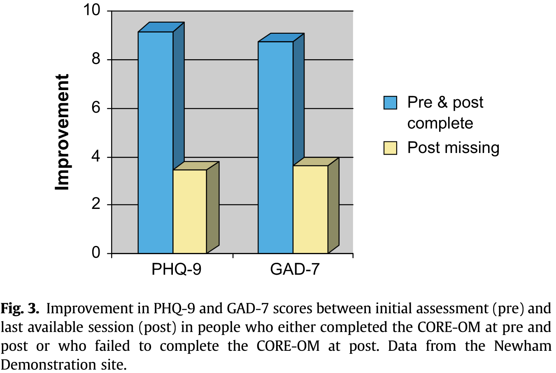
Return rates for post-treatment data
People who complete followup questionnaires tend to have show better outcomes
Missing data – worse outcomes
→ Artificial inflation of outcome
Clark et al (2009)

Slide 52
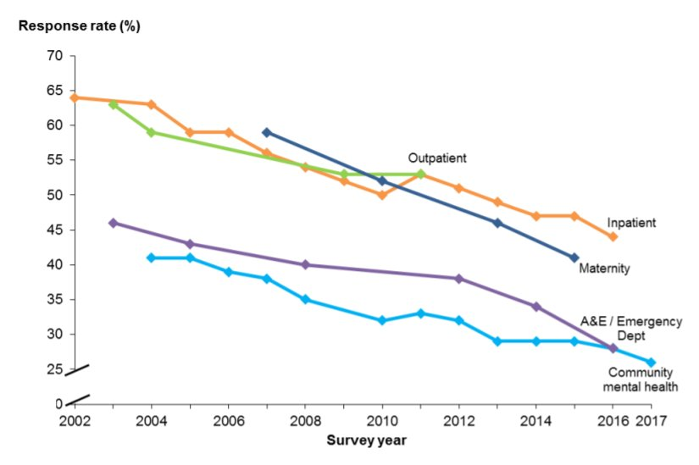
Response rates on the NHS Patient Survey Programme

Slide 53
Goodhart’s (1975) law
“Any observed statistical regularity will tend to collapse once pressure is placed upon it for control purposes”

Slide 54
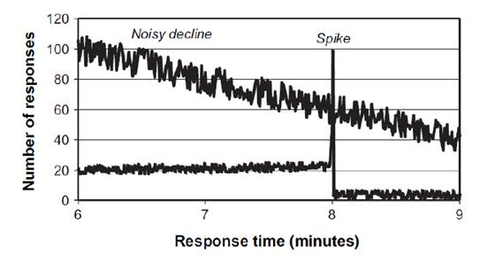
Implication of Goodhart’s law
(see Bevan and Hood, 2006)

Slide 55
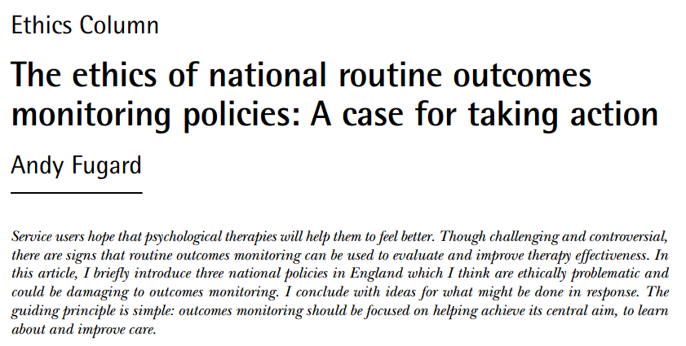

Slide 56
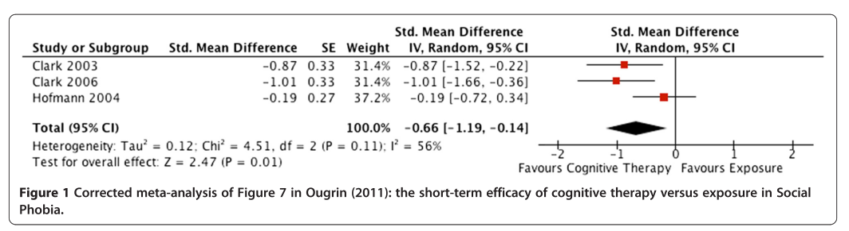
Maybe some interventions are better than others?
Ebrahim, S., & Bance, S. (2012). Correcting and interpreting the effect of cognitive therapy versus exposure in anxiety disorders. BMC Psychiatry, 12, 202.

Slide 57
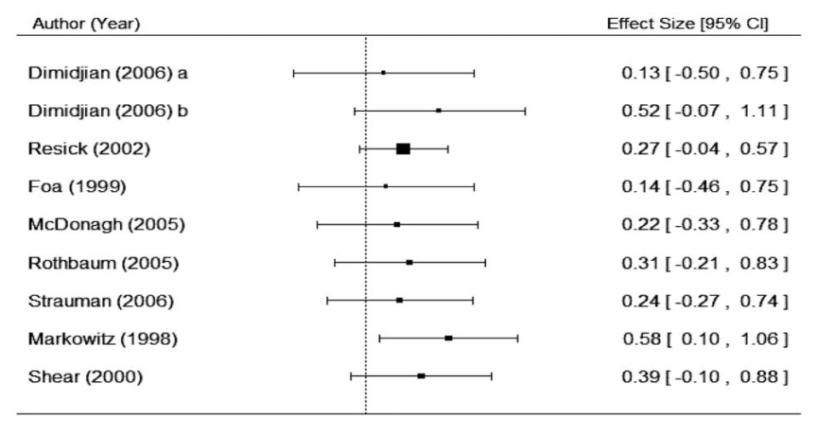
… but they’re rare and expensive to find (e.g., $11,760,874 NIMH grants → 1 difference)
Laska, Gurman & Wampold (2014)

Slide 58
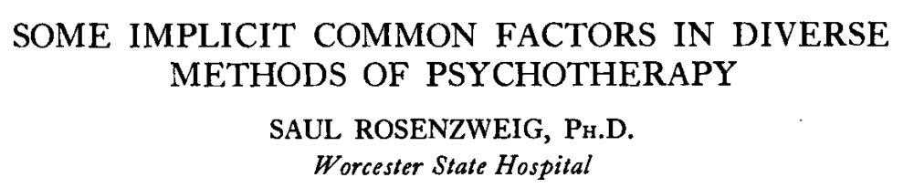
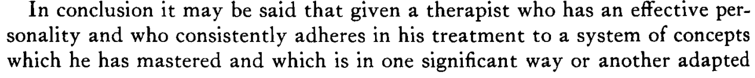
An old idea (1936)

Slide 59
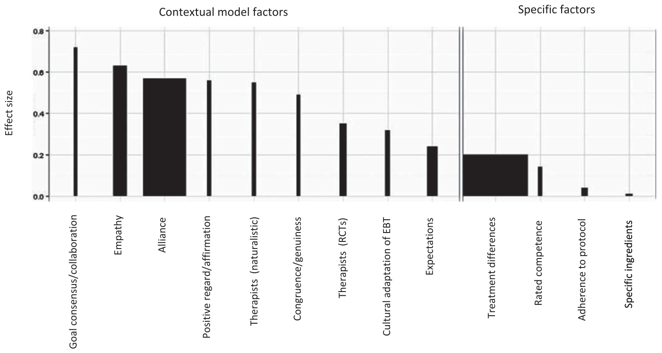
The statistical evidence in one slide
Wampold, B. E. (2015)

Slide 60
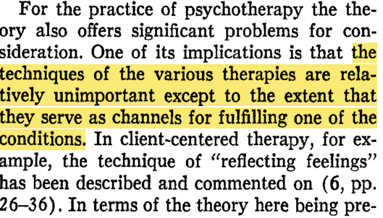
Rogers, C. R. (1957). The necessary and sufficient conditions of therapeutic personality change. Journal of Consulting Psychology, 21, 95–103.

Slide 61
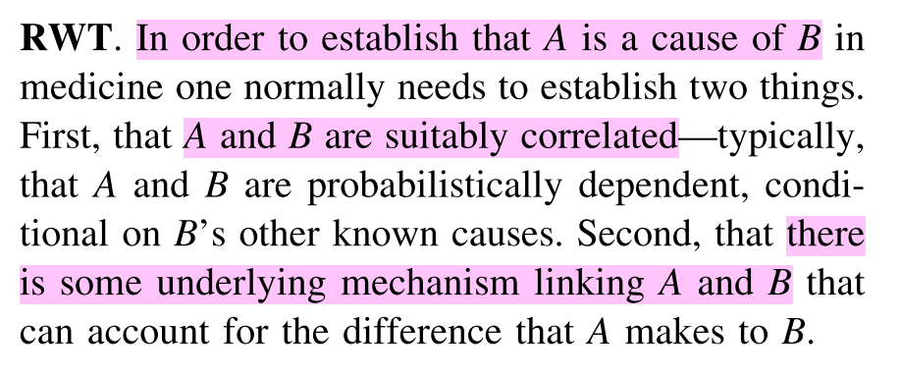
Statistical change doesn’t imply causation Not even with an RCT! (Clarke, Gillies, Illari, Russo, & Williamson, 2013)

Slide 62
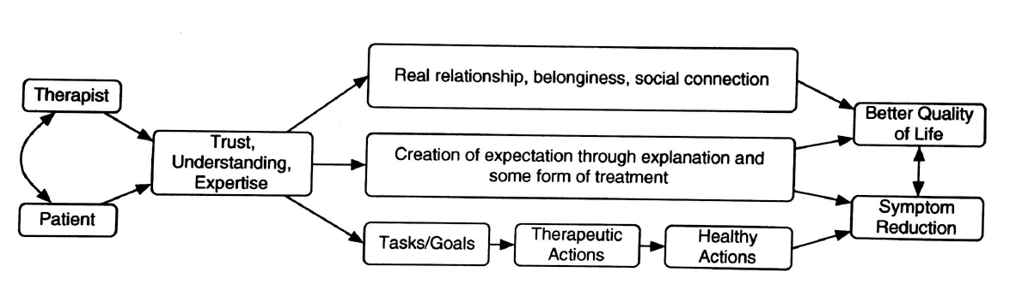
The contextual model (Wampold & Imel, 2015)
An activity that “results in an increase in something healthy or a decrease in something unhealthy” (p.60)

Slide 63

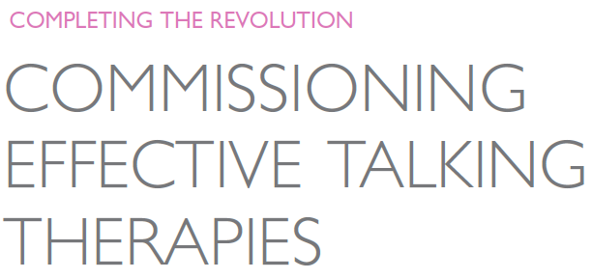
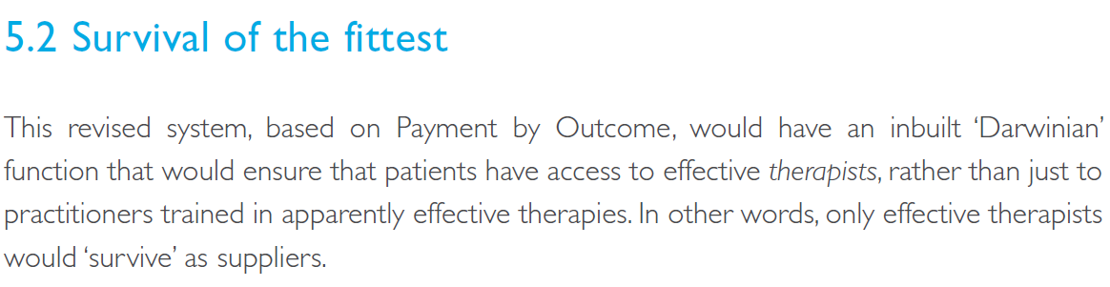
(2012)

Slide 64
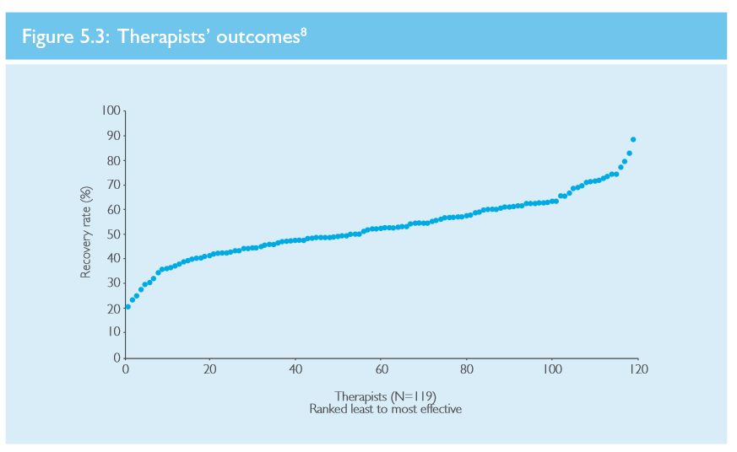

Slide 65
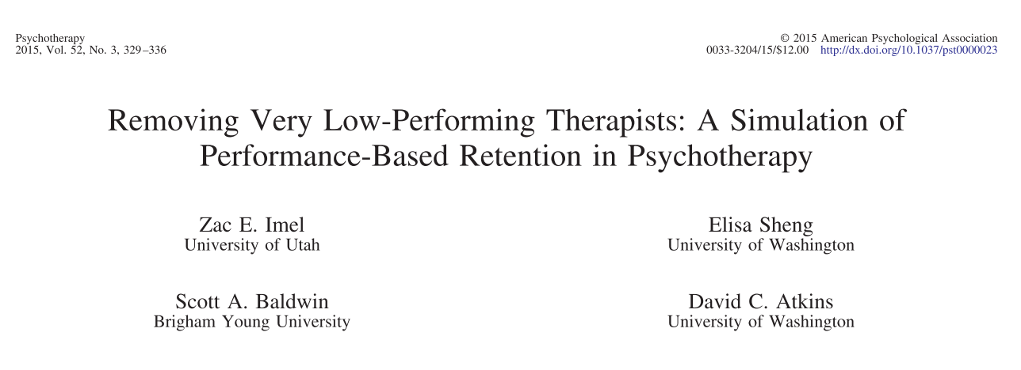

Slide 66
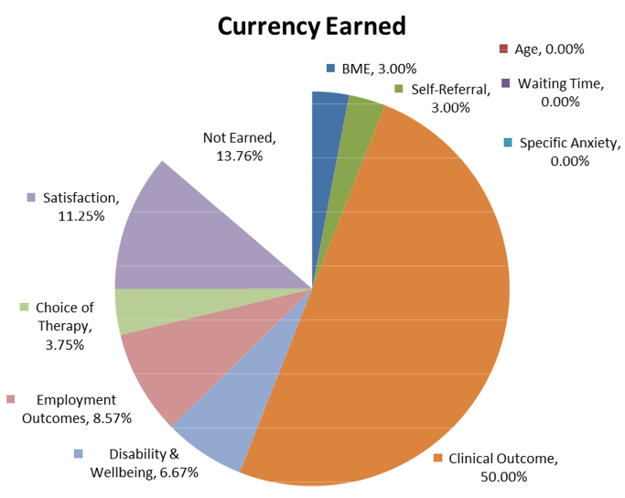
Proposed adult IAPT PbR – worked example
Currency result: 86.24% for this patient
Price = £1,500 x 0.8624 = £1,293.62

Slide 67
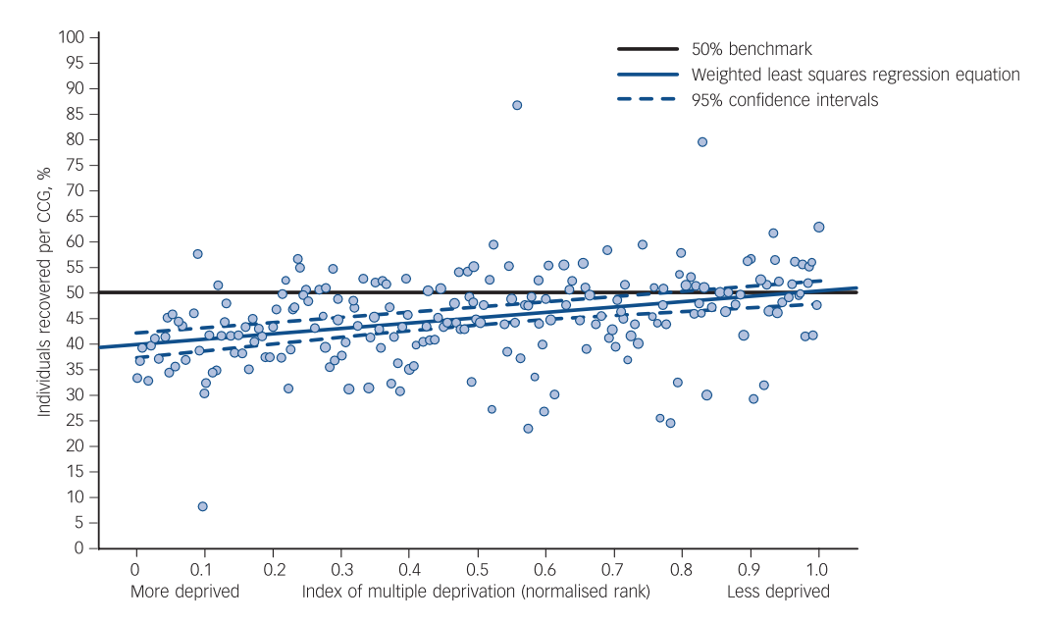
Delgadillo et al. (2016)

Slide 68
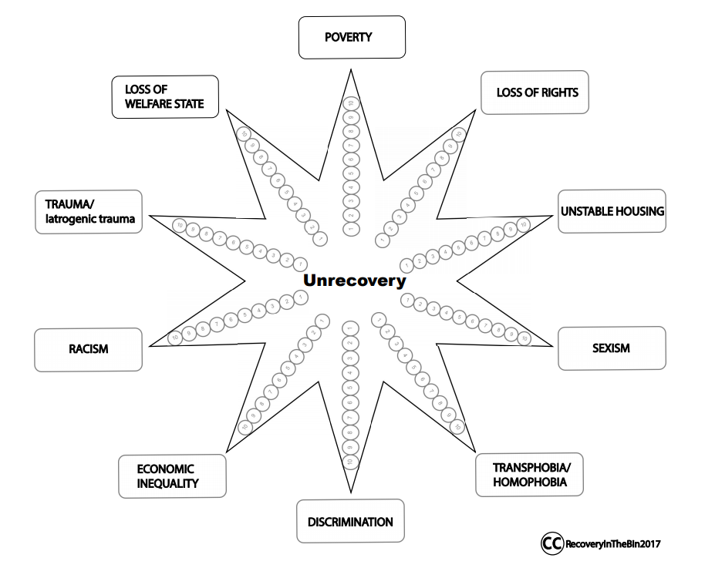
https://recoveryinthebin.org/

Slide 69
The end
a.fugard@bbk.ac.uk
@InductiveStep

